Slide 1

EXPLORING IN-DEPTH BANK ACCOUNT FRAUD

Slide 2
Objective and Approach
Objective: To identify fraud in credit card applications, the primary dataset from Bank Account Fraud (BAF) enabled us to conduct data analysis, preprocess data, and develop machine learning models for fraud detection.
Approach: The group individually analyzed the data set and leveraged different models before identifying and agreeing on the best performing model.

Slide 3
Data Overview
Dataset was sampled from 1 million rows to 200,000
The dataset is loaded using pandas.
Data types and null values are reviewed.
Analysis is performed on the distribution of the target variable "fraud_bool."
Categorical columns are encoded using OneHotEncoder, and numerical columns are scaled.
The dataset undergoes normalization using PCA (Principal Component Analysis).

Slide 4
DATA COLLECTION
Reasons for selecting our dataset:
Realistic - based on real-world bank account fraud scenarios making it relevant for our model.
Scale - over 1 million instances and 32 features (Scaled Down), this data set provides sufficient data for training complex models and helps reduce risk of overfitting.
Documentation - detailed data sheet and research papers associated provide guidelines for effective use.
Imbalanced Classes - extreme imbalance of classes (fraud and not) reflects real world scenarios leading to solutions such as sampling techniques.
Dataset: https://www.kaggle.com/datasets/sgpjesus/bank-account-fraud-dataset-neurips-2022

Slide 5
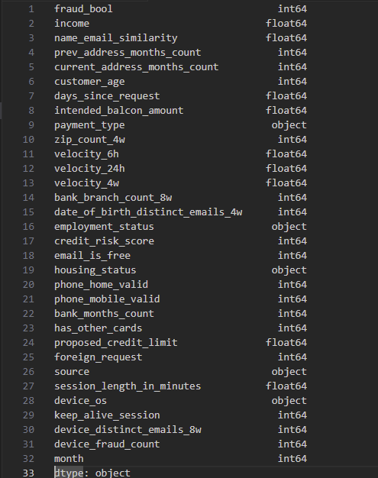
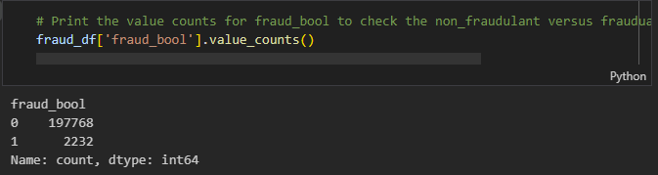
Data Inspection
Data is loaded using pandas.
Data is displayed.
Datatypes and column names are verified.
Analysis is conducted on the target variable "fraud_bool."
Categorical and numerical values are identified for data transformation purposes.

Slide 6
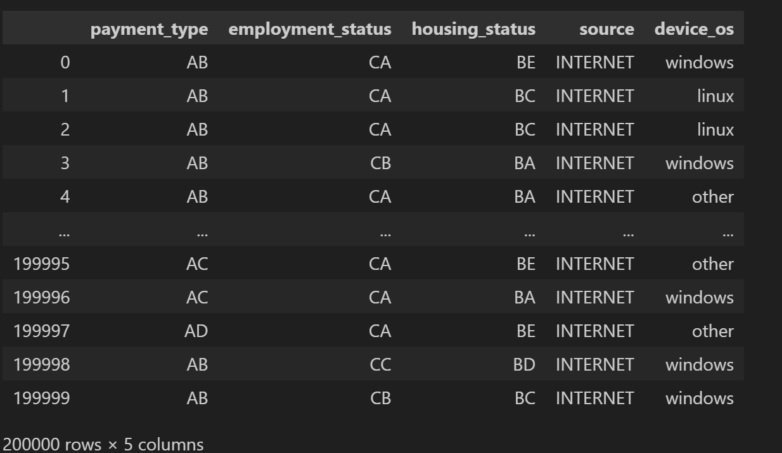
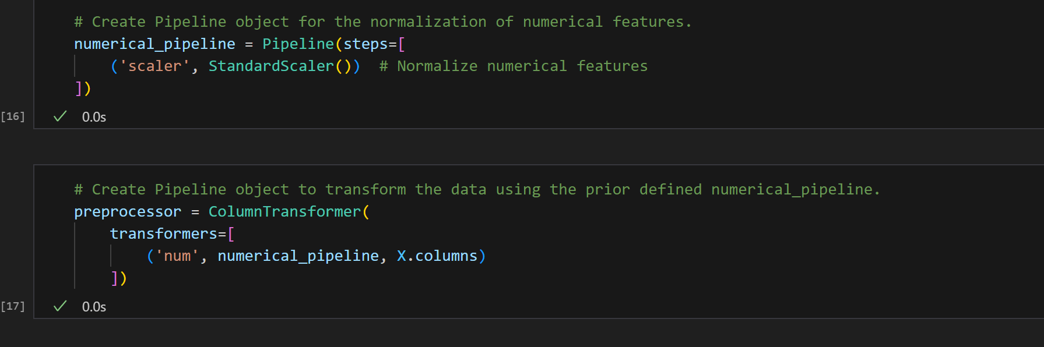
One-hot encoder/Standard Scaler
Separated object data
Created object for:
payment_type
employment_status
housing_status
source
device_os
Pipeline for numerical features.

Slide 7
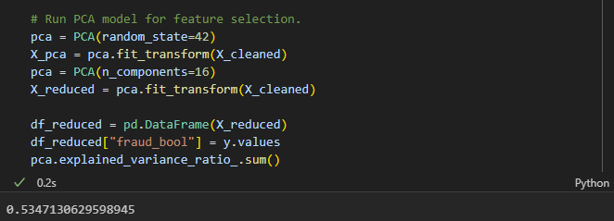
PCA
PCA Principal Component Analysis is used for feature reduction
PCA is applied with random_state=42 to clean data.
Features are reduced to 16 principal components with explained variance of 53%.
New data is integrated into model

Slide 8
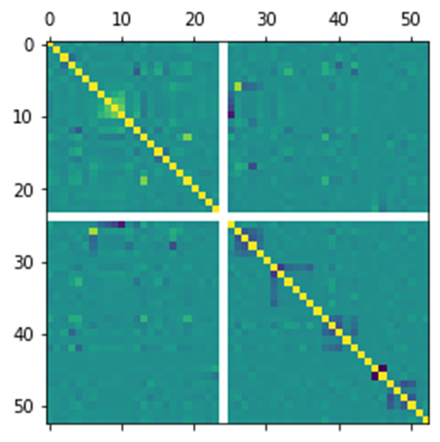
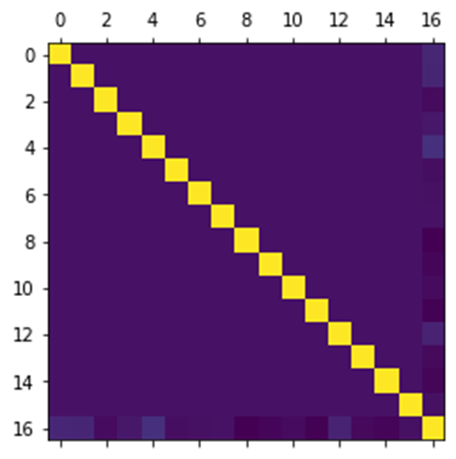
Correlation Matrices pre- and post-PCA
BEFORE
AFTER

Slide 9
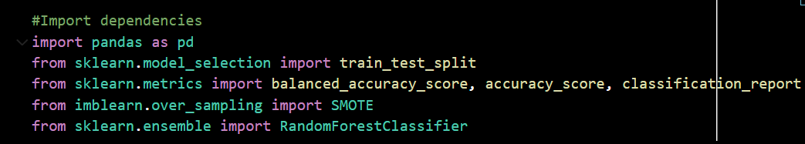
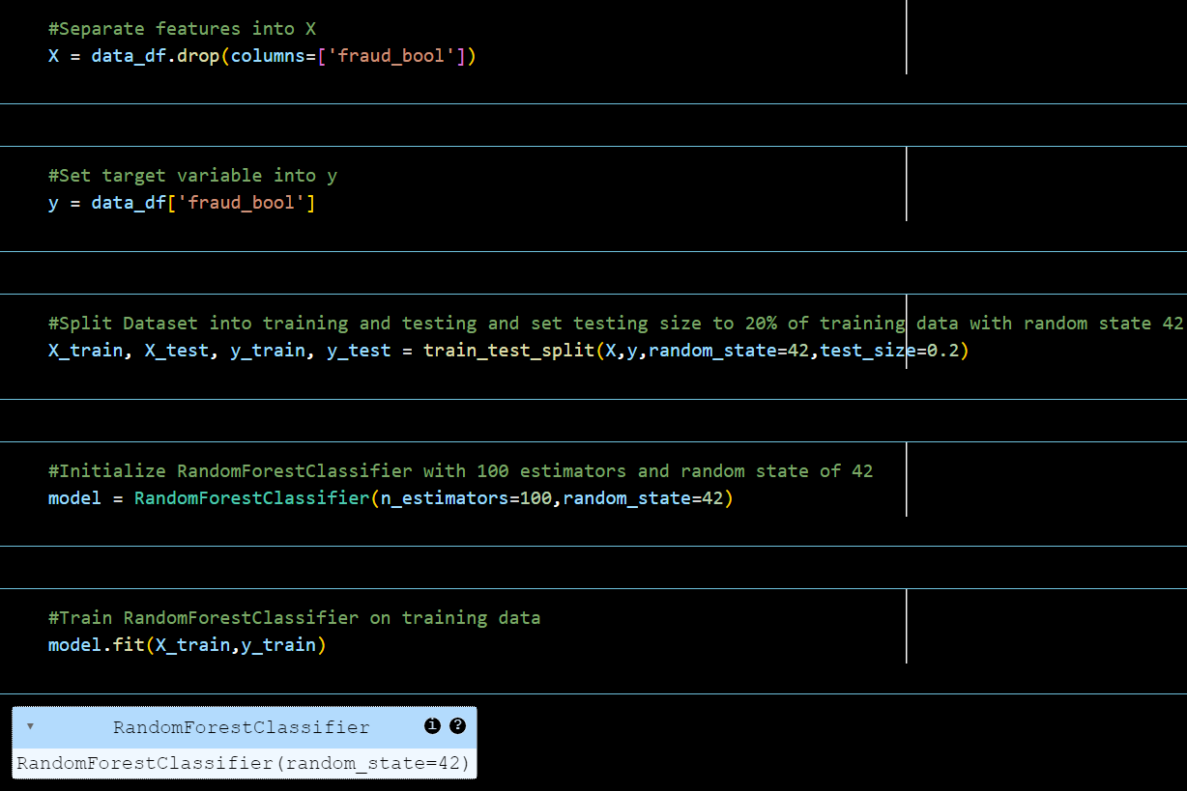
Initial Model Creation Overview
Random Forest Classifier
Import dependencies:
Initialize dataframe with preprocessed data.
Create X and y variables from base dataset.
Separate into training and testing data.
Initialize the base model:
n_estimators = 100
random_state = 42
Fit model with training data.

Slide 10
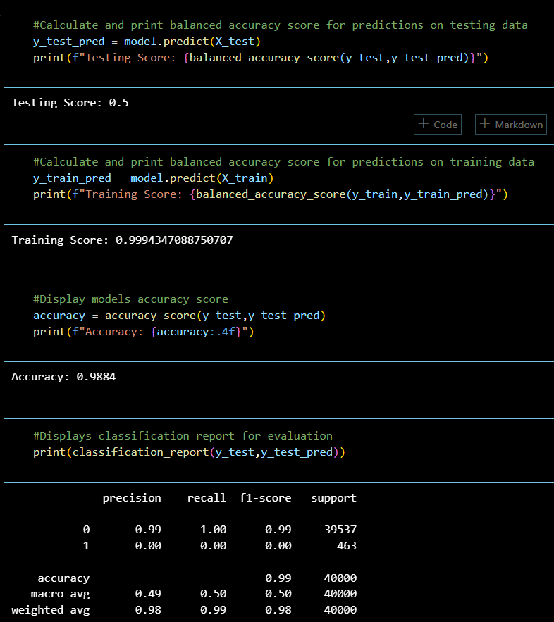
Initial Random Forest Model Results:
Metrics used from sklearn:
balanced_accuracy_score
accuracy_score
classification_report
Result Highlights:
Balanced Testing score: 50%
Balanced Training score: ~100%
Accuracy Testing score: ~99 %
Key Observations:
fraud_bool column has 99% precision on non-fraudulent data.
fraud_bool column has 0% precision on fraudulent columns.
Indicating the dataset is imbalanced.

Slide 11
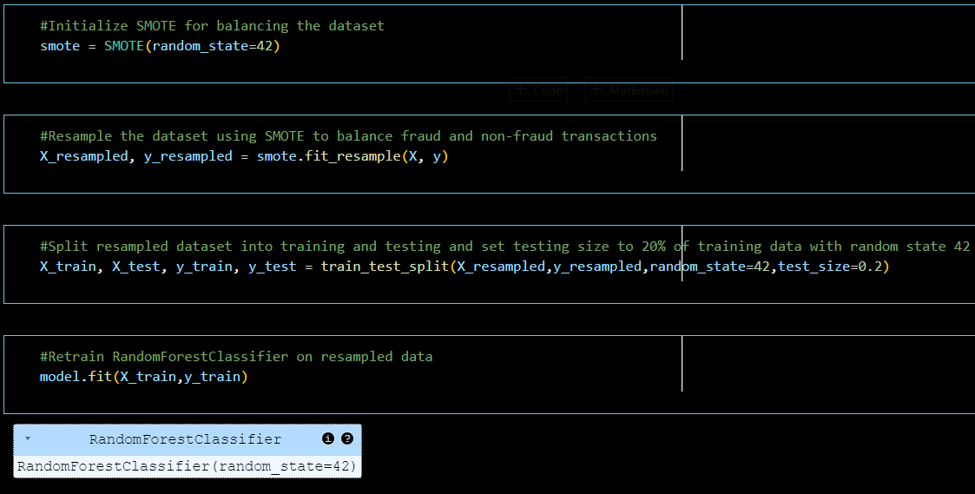
Model Trained on Oversampled Dataset Overview:
Initialize SMOTE object for balancing dataset.
random_state = 42
SMOTE is an external library that is utilized in balancing datasets using over-sampling techniques. (SMOTE)
Resample the dataset using SMOTE object to balance fraud and non-fraud rows.
Split the resampled data into training and testing variables.
random_state = 42
test_size = 0.2 (20% of testing data)
Retrain the RandomForestClassifier model on the resampled data.

Slide 12
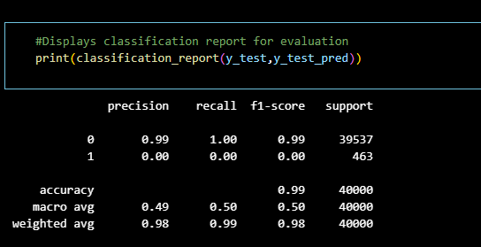
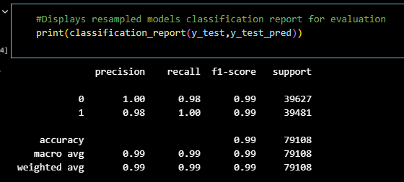
CONCLUSION & NEXT STEPS
Before SMOTE
Conclusion: The graphics at left demonstrate the initial classification report, the improvements through iterations of testing and training to the final classification report clearly showing a more balanced model and improved performance.
Next Steps / Additional Questions: Our results peaked our curiosity to analyze additional dimensions and testing our model leveraging real-world anonymized data.
After SMOTE

